Slide 1

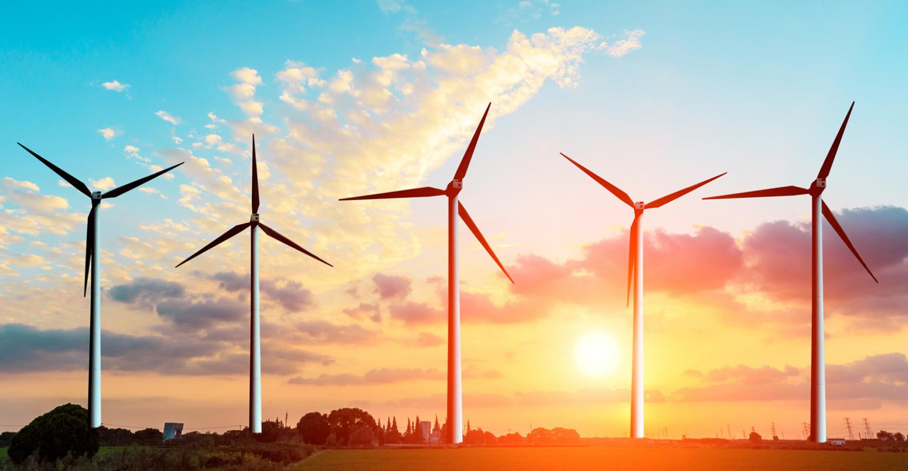
Energy conserved is energy produced.

Slide 2
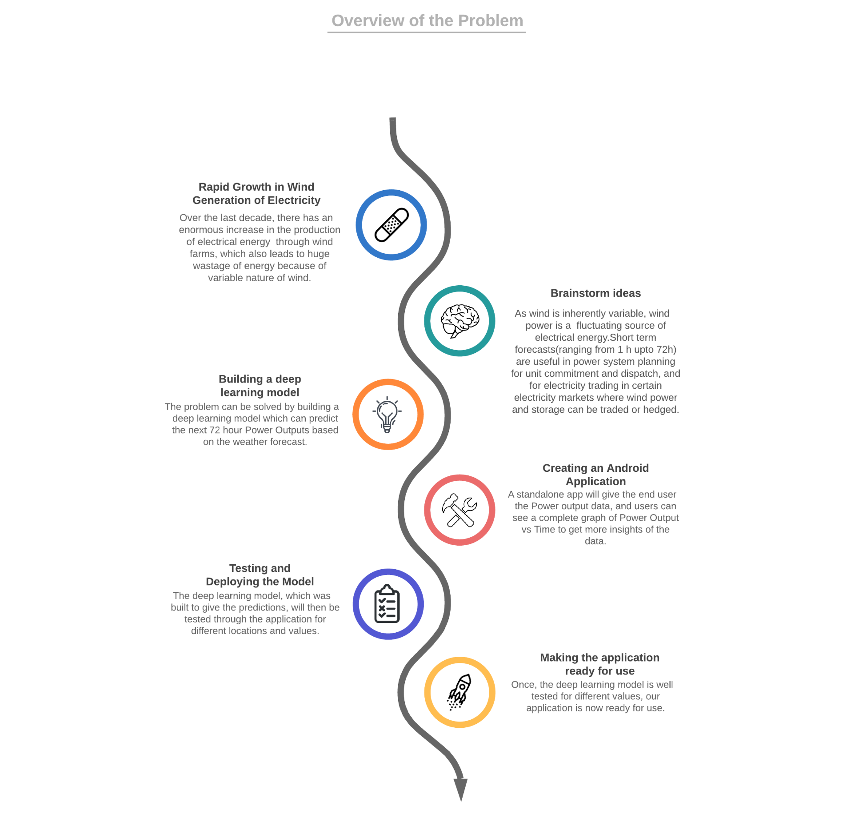

Slide 3
THE EVOLUTION AND FUTURE OF WIND MARKETS
EVOLUTION OF THE WIND INDUSTRY
Rising concerns about climate change, the health effects of air pollution, energy security and energy access, along with volatile oil prices in recent decades, have led to the need to produce and use alternative, low-carbon technology options such as renewables. Wind power has been a pioneering renewable technology in recent decades. In terms of total installed capacity, wind power is the leading renewable energy technology after hydropower, with more than half a terawatt installed globally as of the end of 2018. Along with solar, wind also dominated total renewable capacity additions, with around 43 GW of wind capacity added globally in 2018 (IRENA, 2019d).
The evolution of the wind industry has been remarkable, and in the last four decades several milestones have been achieved in installations, technology advancements and cost reductions along with the establishment of key wind energy associations. By 2020, onshore wind is set-to consistently offer a less expensive source of new electricity than the least-cost fossil fuel alternative in most regions (IRENA, 2019c).
Wind power will remain a key renewable energy option in the coming decades. This report sheds light on the prominent role of wind power in transforming the global energy landscape by 2050. The following sections cover an accelerated deployment pathway for wind power (onshore and offshore) until 2050 under the REmap Case in IRENA’s global energy transformation roadmap, along with perspectives on cost reductions, technology trends and the need to prepare future grids to integrate rising wind power shares. 22

Slide 4
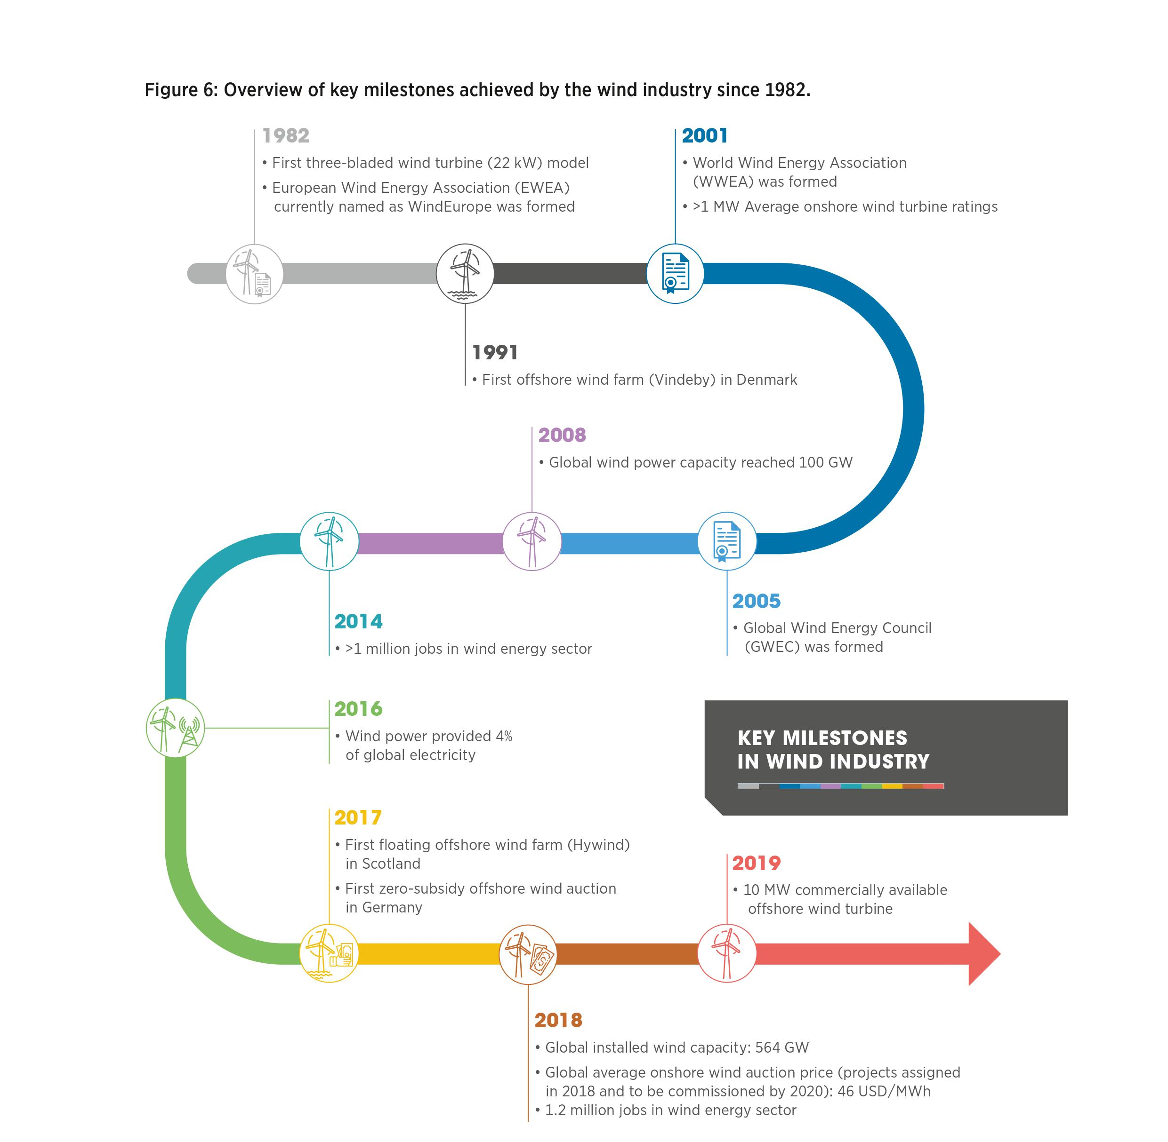

Slide 5
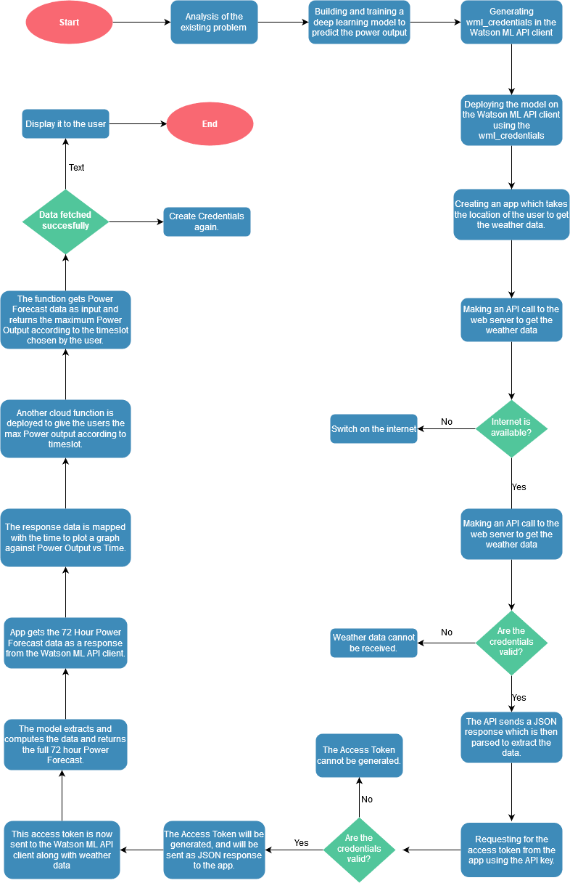
Flowchart of tasks

Slide 6
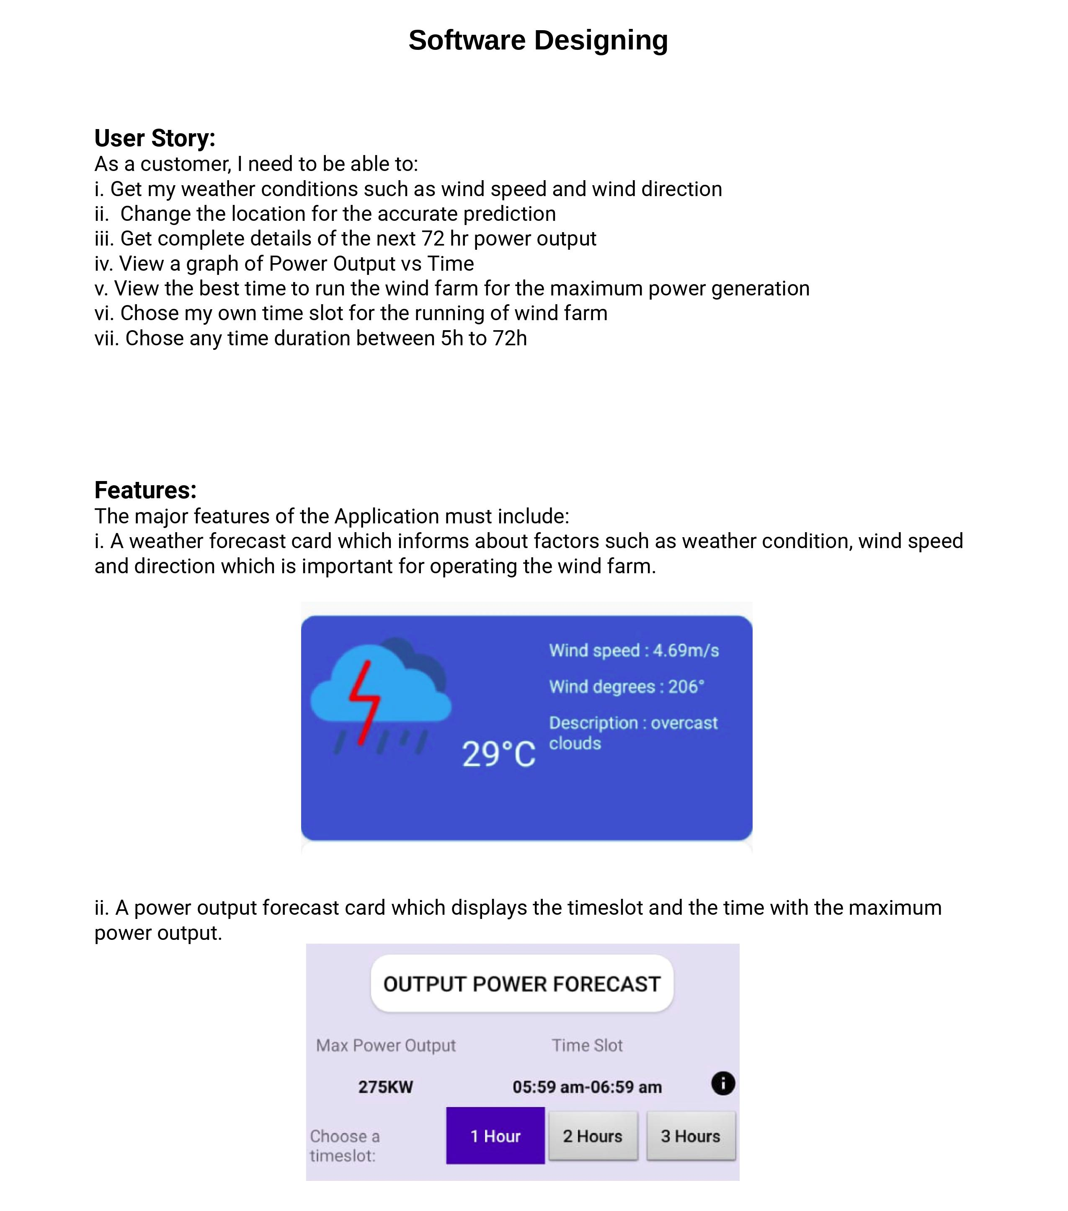

Slide 7
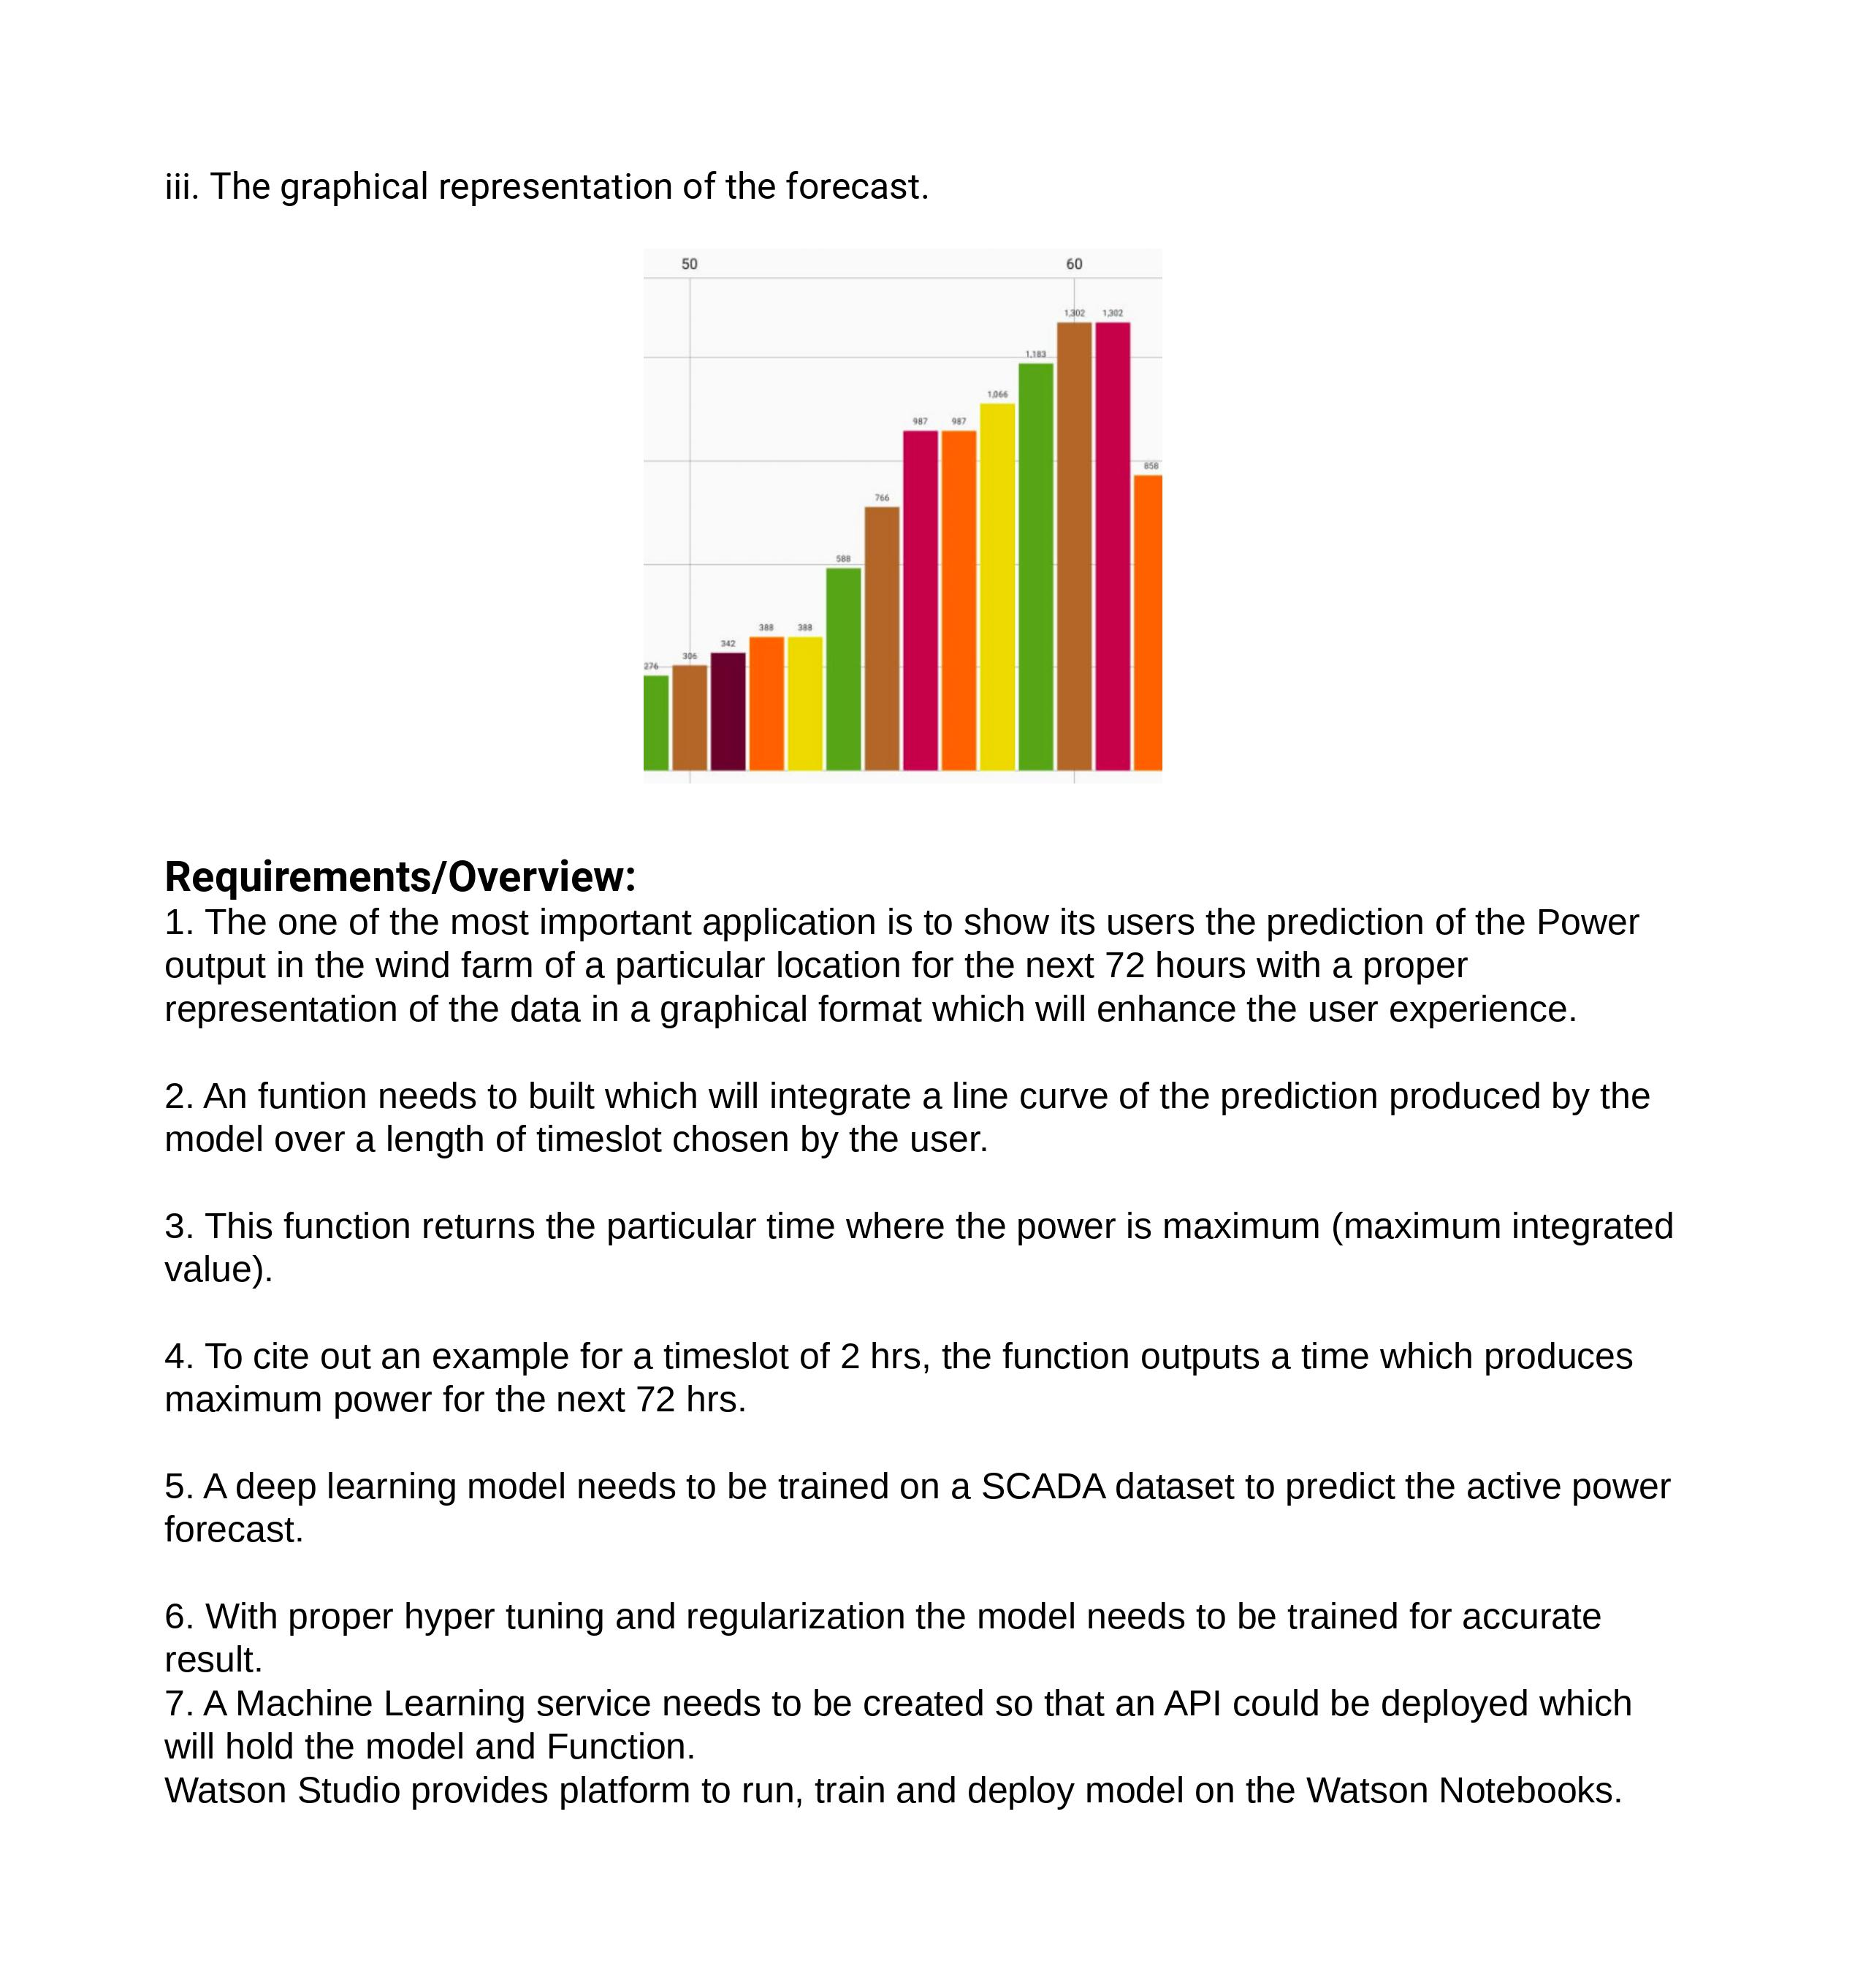

Slide 8
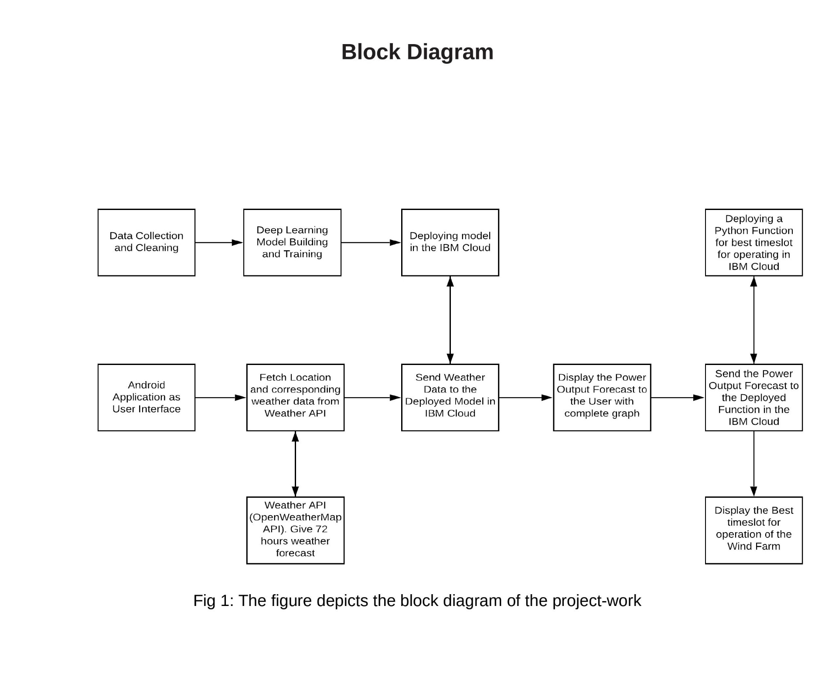

Slide 9
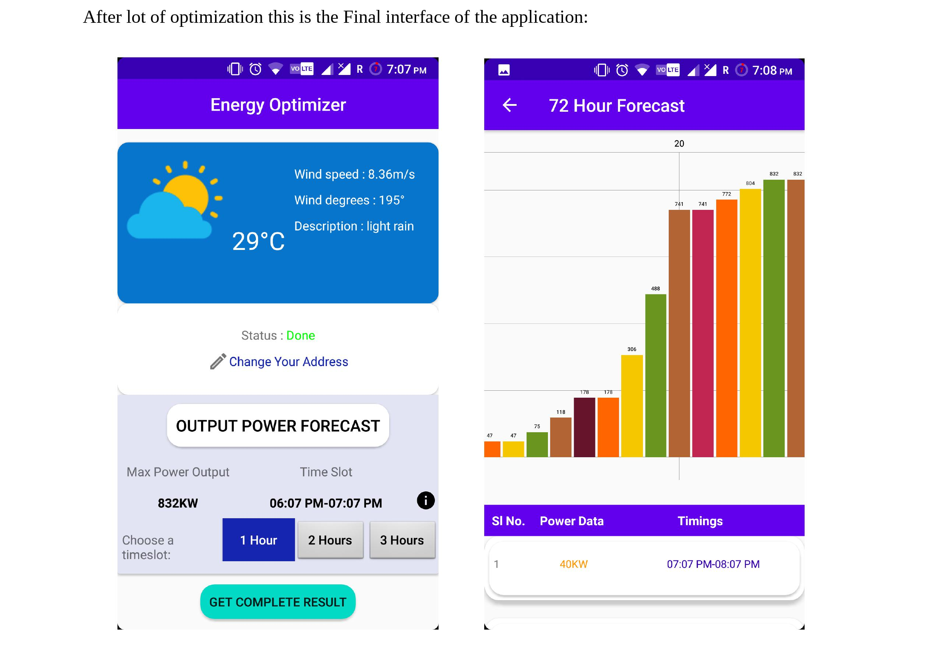

Slide 10
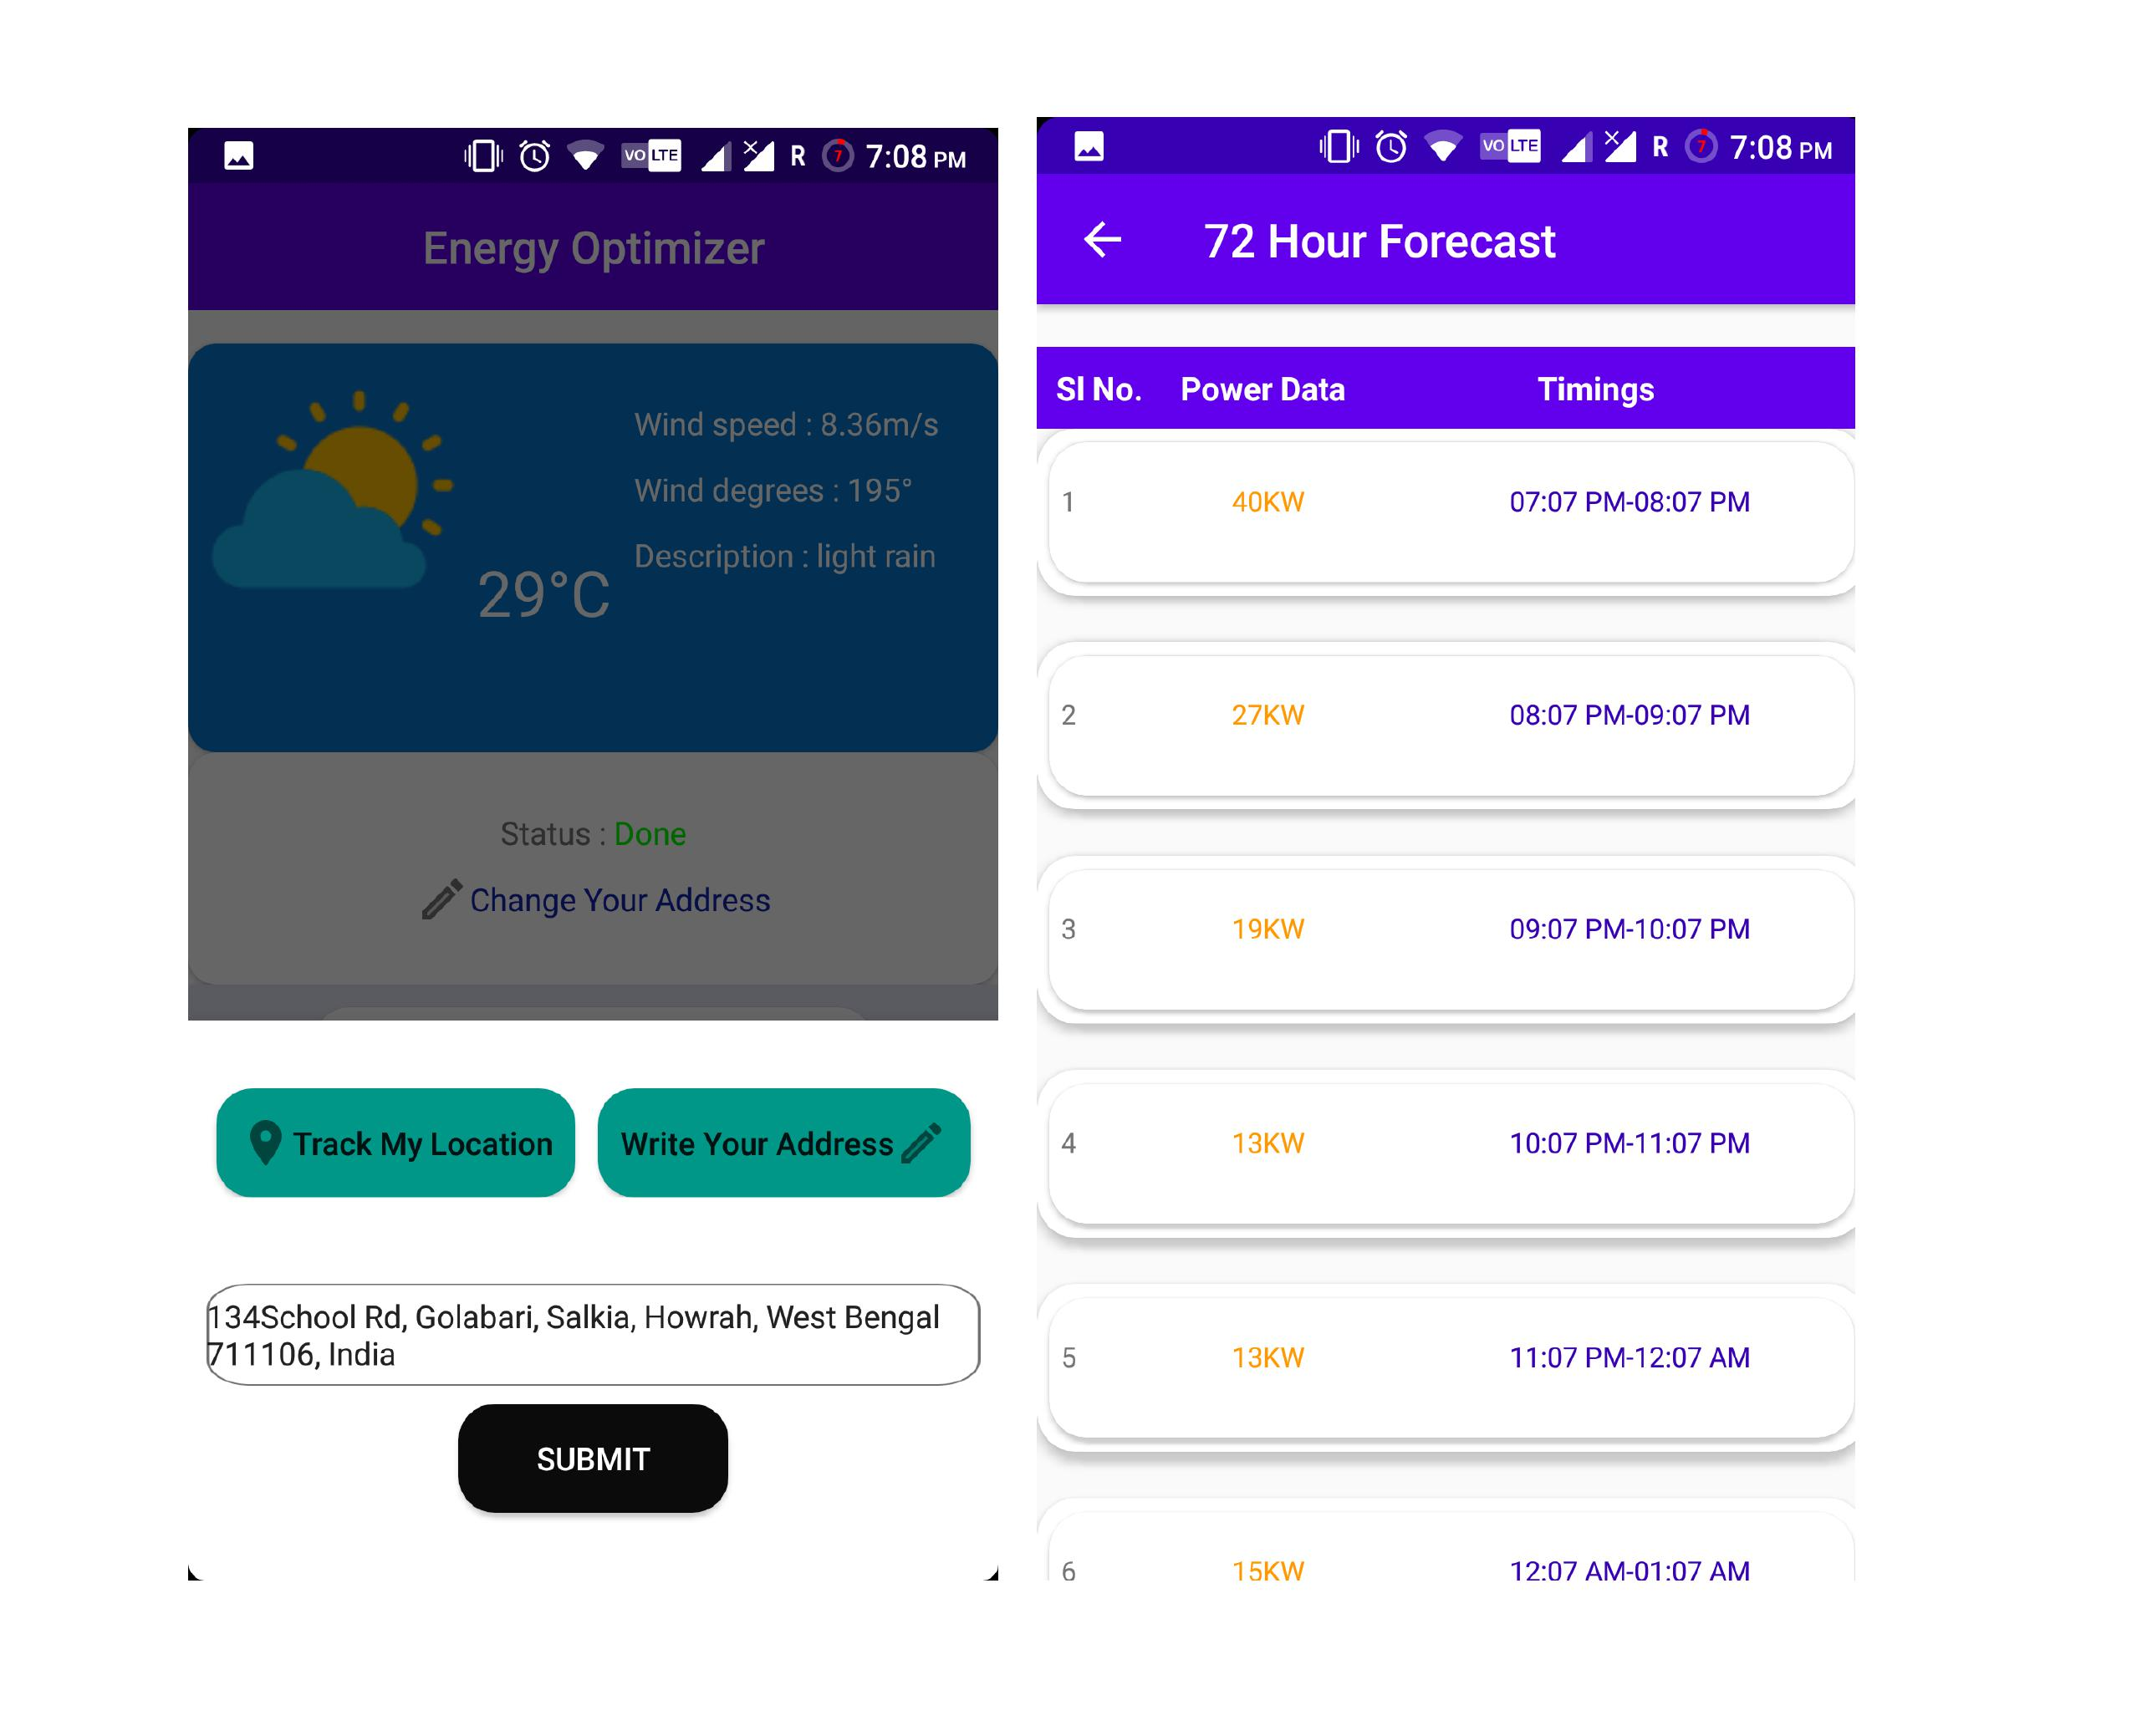

Slide 11
